Slide 1

ALGEBRA EQ: $How do we solve equations?$
Miss D’souza

Slide 2
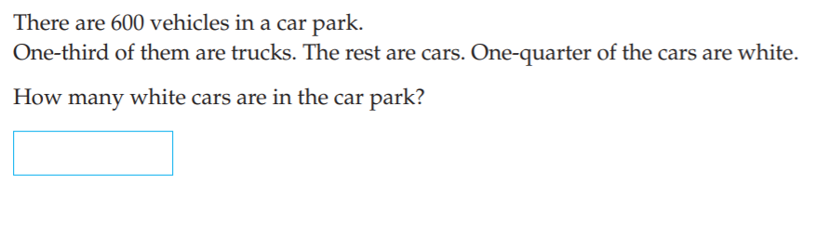

5 questions:
Find the outlier (15, 9, 10, 21, 25, 29, 42)
Give an example of collecting categorical data
$15a+6a+2b=$
Expand the brackets; $4(x−10)$
.

Slide 3
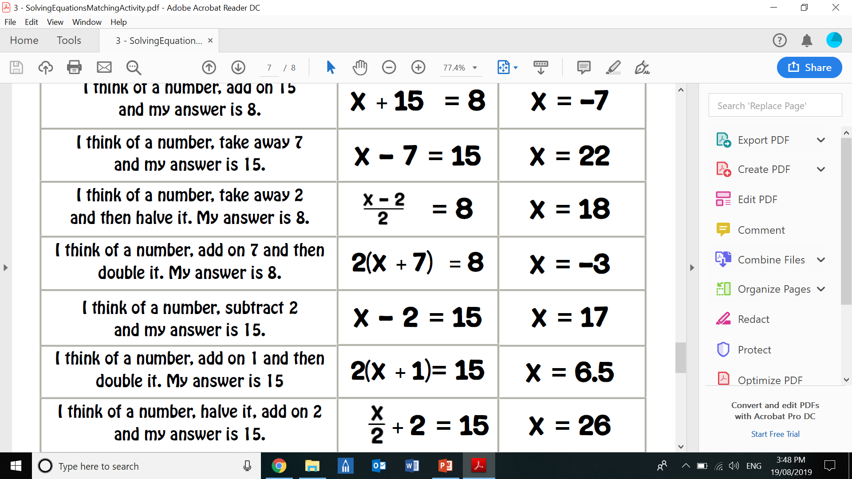
GROUP ACTIVITY
In groups of 2 you will need:
1x A3 paper
Scissors
glue
CUT and glue three cards that match
EXAMPLE:

Slide 4
Copy 5 examples into your Interactive notebook
Complete a summary and add a glossary word

